Slide 1


Seminar for Tax Preparers
CCRI Newport/Warwick

Slide 2
  Speakers
  Michael Canole, Assistant Tax Administrator
  Kimberly Del Gallo, Chief Revenue Agent
  Leo Lebeuf, Assessment and Review Chief of Tax Processing
  Theriza Iafrate, Chief Revenue Agent

Slide 3
Taxportal.ri.gov
Kimberly Del Gallo, Chief Revenue Agent

Slide 4
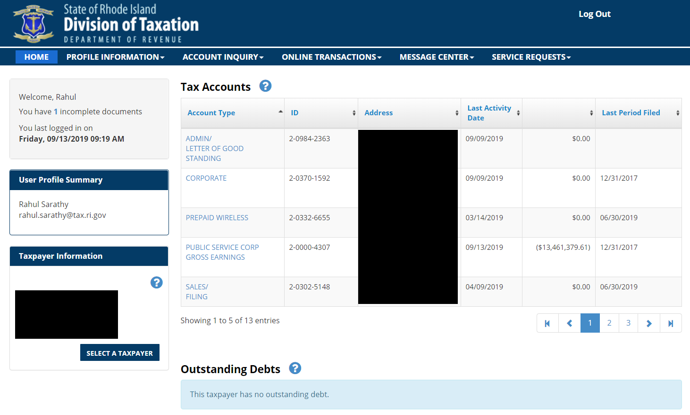
New Taxation Portal is live!
taxportal.ri.gov

Slide 5
Why use the new Portal?
FUNCTION | RI.GOV (current) | STAARS PORTAL (future)
File & Pay a Tax Return | Not supported except for Sales Annual return | Supported for all taxes that are not currently processed through IRS interface
Make a Tax Payment | Allows for a payments to be made using manually entered ID and tax filing code | Allows for Final, Estimated, Extension and Bill Payments for all tax types with preselected ID
LOGS / Compliance Check | Not Supported | Electronic “Smart” Application with integrated compliance check and attachment capability
Service Requests | Not Supported | Allows for General Inquiry, Power of Attorney, Supporting LOGS Documentation Requests

Slide 6
Why use the new Portal?
FUNCTION | RI.GOV (current) | STAARS PORTAL (future)
License Renewal | Supports Manual entry of license Renewals for Sales and Cigarette Licenses | Supports automated renewals from dedicated, taxpayer specific license page
Taxpayer Payment History | Only available for payments submitted on ri.gov | Customized detailing of all payments, regardless of filing source, along with related information (e.g. effective dates)
Payment Methods | Supports ACH debit for preconfigured tax types Credits cards supported for Bill Payments only | Initial release supports ACH debit for all tax types. Future implementation for Credit Cards and other payment methods automatically extended to all tax types

Slide 7
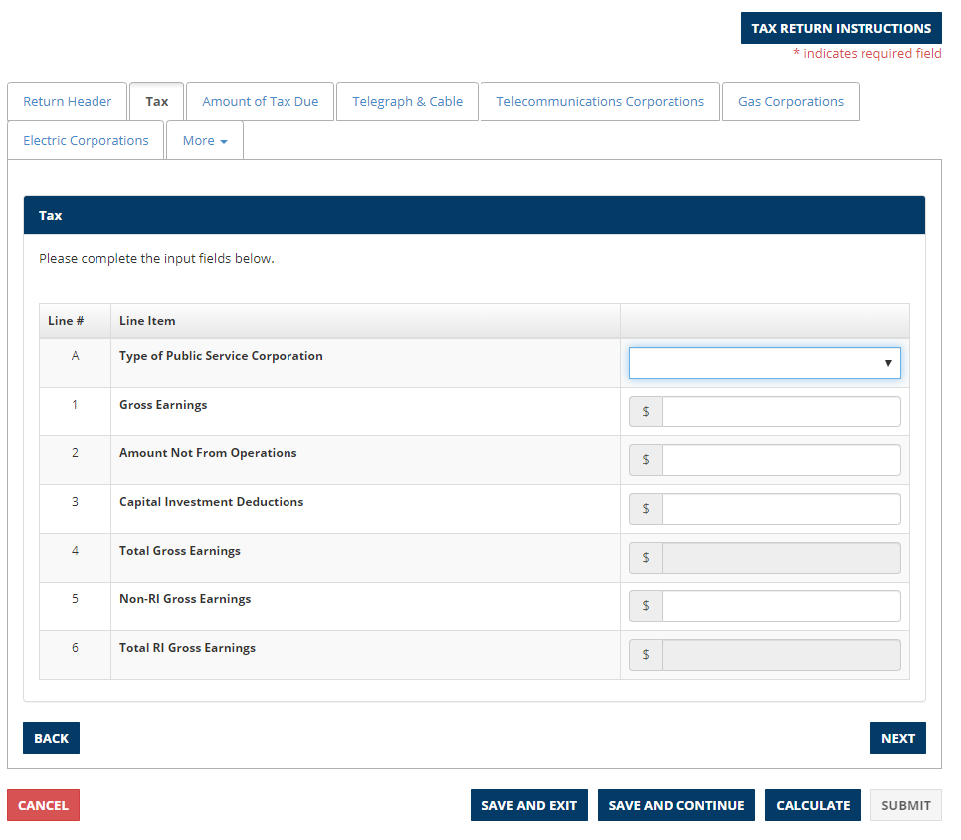
Portal Update
File & Pay Tax Returns
Taxpayers file and pay for returns for all tax types.
  We will not include returns that are included with MEF in order to stay in compliance with the Free File Alliance. (1040,1120,1065 and 1041)
Available Returns are pre-selected based on taxpayer’s registration profile and provides duplicate filing avoidance logic.
Returns automatically calculate line items to provide accurate, transparent results to taxpayer, reducing future taxpayer issues.
If there is tax due, taxpayers are prompted to enter a payment
Ability to Upload Attachment for the Filing
Benefits to Taxpayer: Taxpayer will no longer have to send in paper returns after they have made an electronic payment

Slide 8
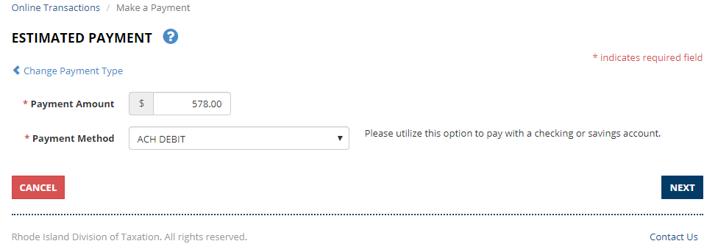
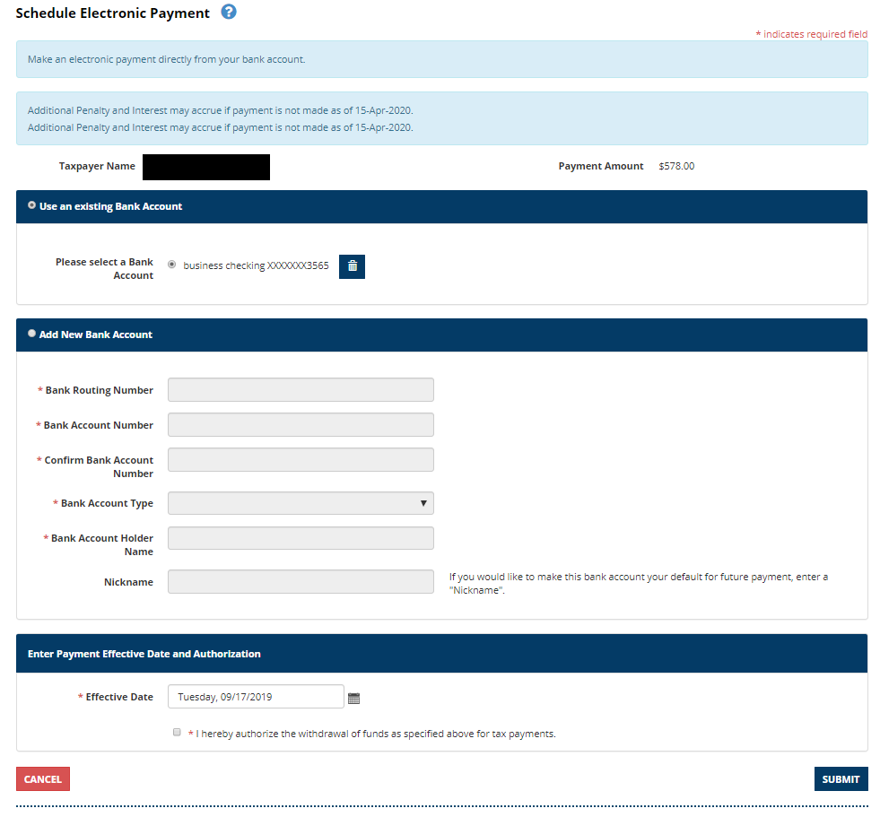
Portal Update
Make a Payment
Taxpayers will be able to make account period payments, bill payments, estimated payments and extension payments for all tax types
Taxpayers will be able to lookup debt details using bill invoice number and make payments via their checking or savings account.
Future release expansion to allow Credit Cards for all payments
Benefits to Taxpayer: Taxpayer will now have the ability to make bill payments via ACH Debit. This will reduce the fees currently paid by taxpayer.

Slide 9
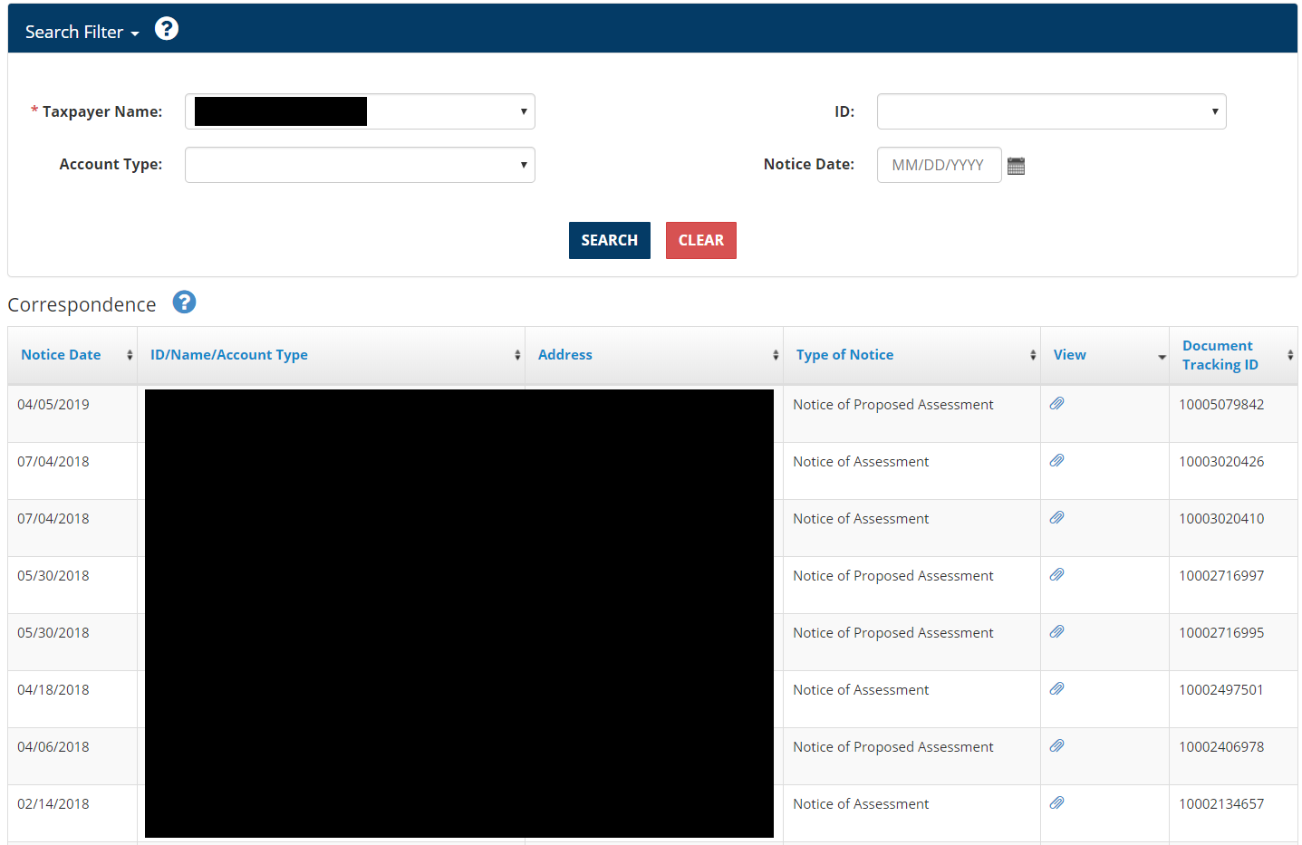
Portal Update
Electronic Correspondence
Allows taxpayer to view and print copies of the notices that Taxation has sent.
Benefits to Taxpayer: Readily available inventory of notices received from Division of Taxation

Slide 10
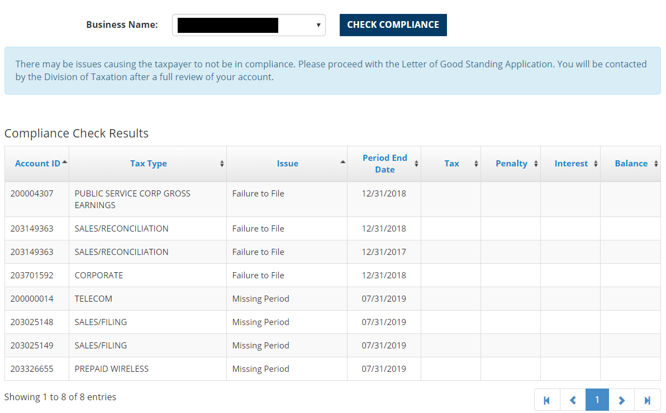
Portal Update
Compliance Check
Taxpayer prompted to check compliance of their accounts to ensure smooth LOGS application process
Compliance check include looking for outstanding debts, return issues and periods missing returns
Benefits to Taxpayer: Quick and Accurate way to determine Compliance with the Division of Taxation

Slide 11
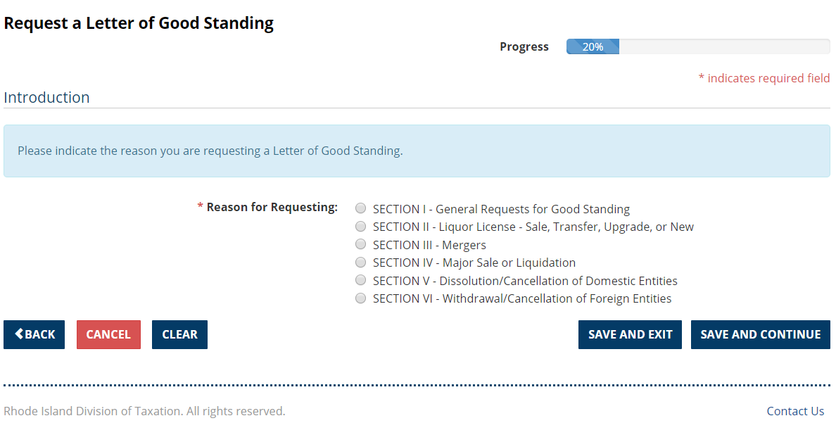
Portal Update
LOGS Application
Taxpayer prompted to check compliance of their accounts to ensure smooth LOGS application process
Smart Application helps taxpayer navigate and correctly fill out application
Service Requests allow for follow up LOGS information to be provided via Portal
Benefits to Taxpayer: Simpler, intuitive interface for requesting a LOGS; clarity as to primary issues that would prevent a LOGS from being issued

Slide 12
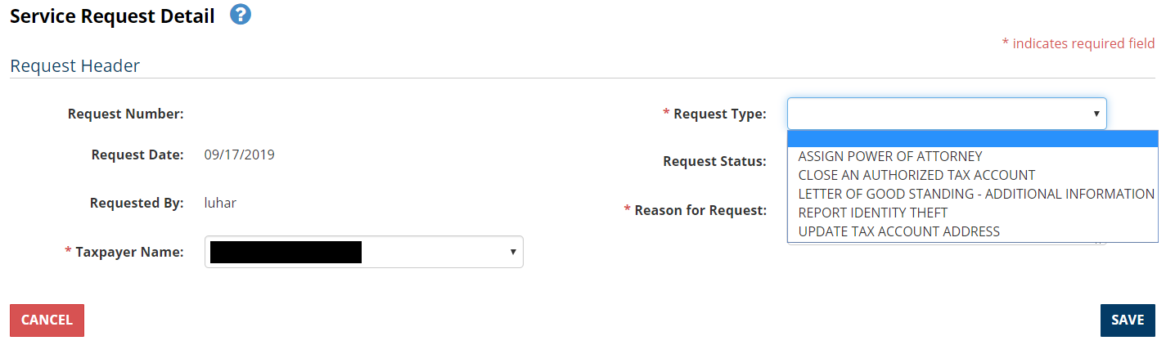
Portal Update
Service Requests
Taxpayers can submit copies of Power of Attorney, uploaded directly to their profile via portal
Taxpayers can request to update address of their profile and accounts via portal
Taxpayers can follow up and provide additional information concerning an open LOGS Application
Benefit to Taxpayer: Reduces Taxpayer burden for submission of service requests by providing for electronic filing

Slide 13
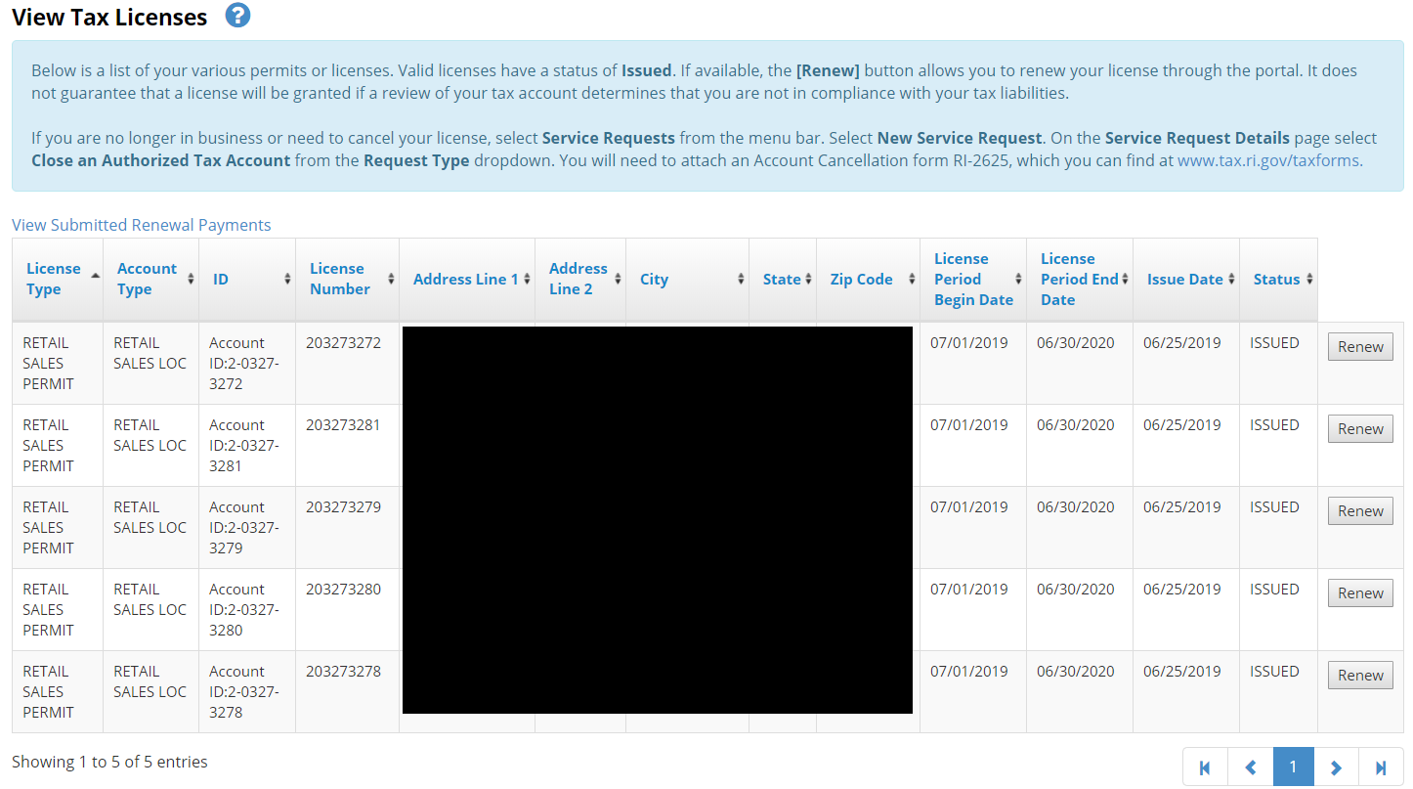
Portal Update
License Renewal
Taxpayers can navigate to a dedicated page to see their licenses, their effects dates and the license status
When a license is available to be renewed, a single “renew” button prompts the taxpayer to make a payment for automatic renewal
Benefit to Taxpayer: Taxpayer can discern from the landing page if there are outstanding debts that may prevent a license from being issued; full transparency into the status of a license

Slide 14
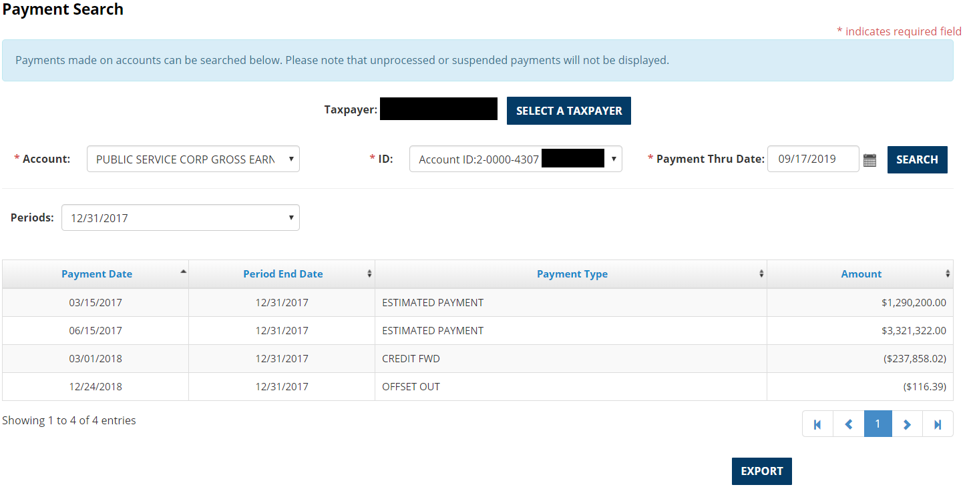
Portal Update
Taxpayer Payment History
Payment history for taxpayer available regardless of payment type and payment source
Feature created specifically to meet the taxpayers/preparers requests.
Ability to Export Data
Benefits to Taxpayer: Payment history helps preparers ensure that the returns are filled in correctly concerning that carryforwards, estimated payments, extension payments and other payments in a given

Slide 15
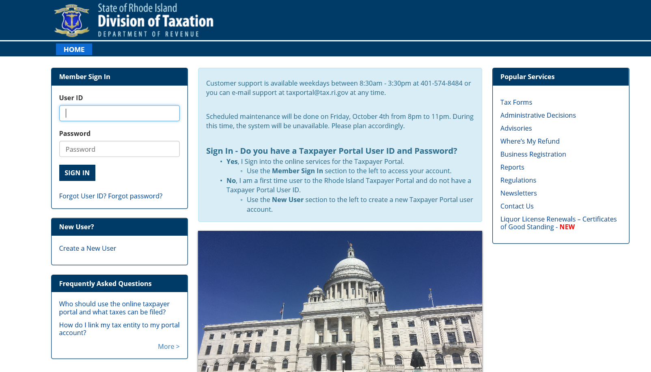
Portal Instructions
Step 1: Visit Taxportal.ri.gov and create a user name and password

Slide 16
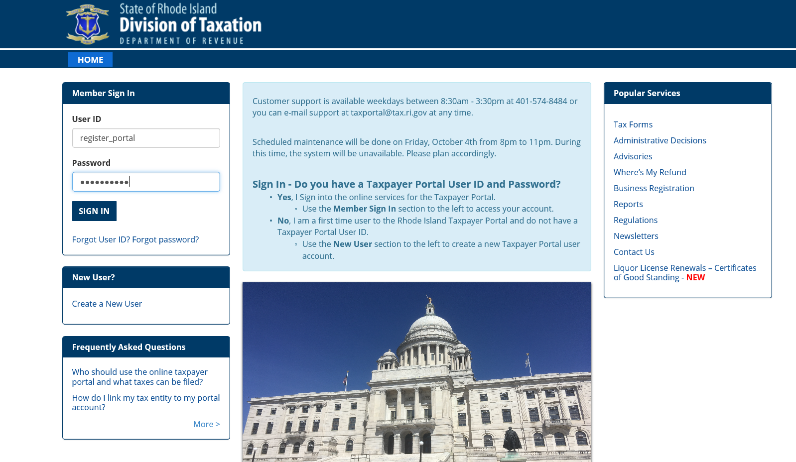
Portal Instructions
Step 2: Get PIN from Taxation
Step 3: Log in using name and password

Slide 17
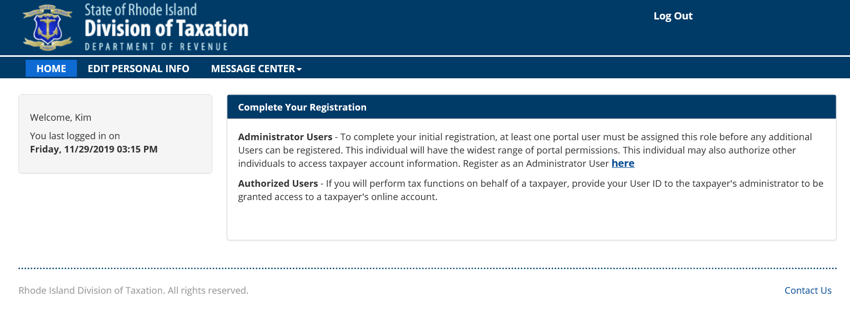
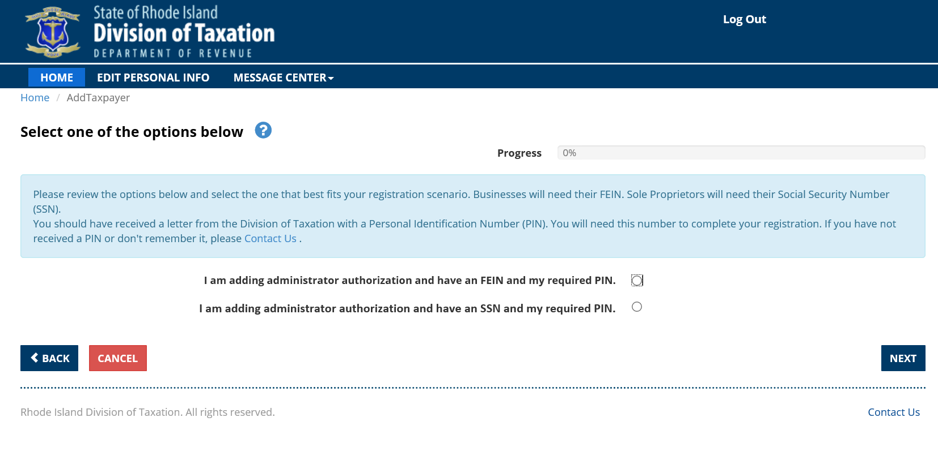
Portal Instructions
Step 4: Link User ID to Taxation using PIN

Slide 18
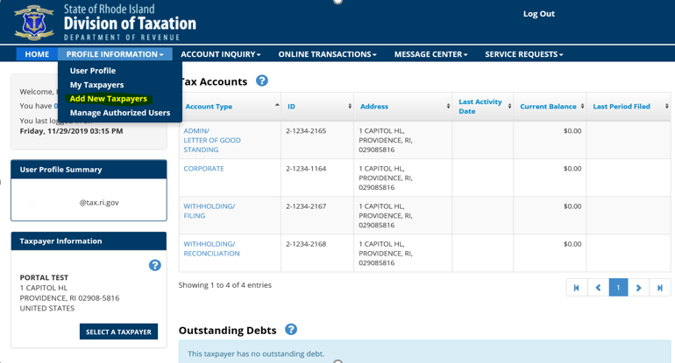
Portal Instructions
Step 5: View your linked taxpayer account

Slide 19
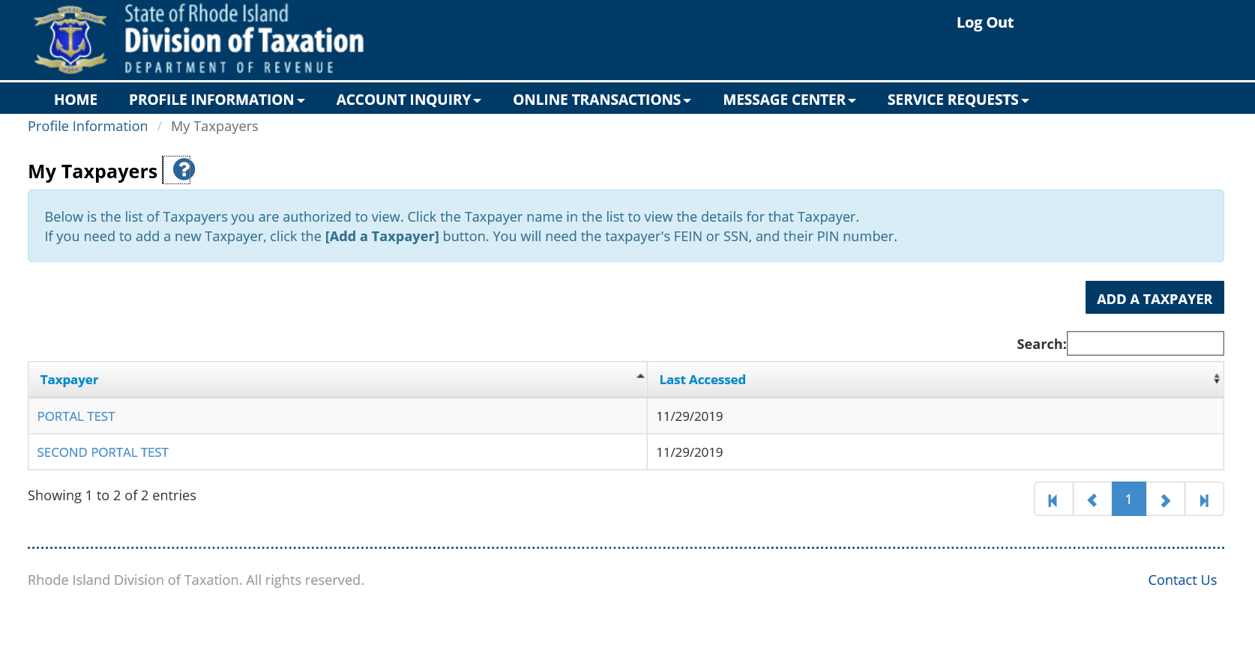
Portal Instructions
Step 6: See all taxpayers linked to your Portal user ID:

Slide 20
Income Tax
Leo Lebeuf, Chief of Tax Processing

Slide 21
Individual Mandate
  RI requirement for every RI resident to have health insurance
  Begins 01/01/2020
  Reported on 2020 income tax return filed in 2021
  Will be based on Federal
  Joint implementation team with HealthSource RI
  Employer Reporting requirement
  Forms still under development
  Outreach beginning soon
  Open Enrollment is 11/01/19 – 12/31/19 (https://HealthSourceRI.com)
  http://www.tax.ri.gov/healthcoveragemandate/index.php

Slide 22
Withholding and Sales Changes
  Withholding E-file and E-Pay mandate – Beginning January 1, 2020
    Average monthly withholding amount of $200 or more
  Electronic methods
    RI.gov portal (for now)
    Taxportal.ri.gov
    ACH Credit
    Credit Card with a fee
  Penalties
    Payment --5% of tax withheld or $500 whichever is less
    Filing--$50 added to the tax
  Sales Tax Changes to come 2021
    Moving away from Annual Rec to a Quarterly Rec

Slide 23
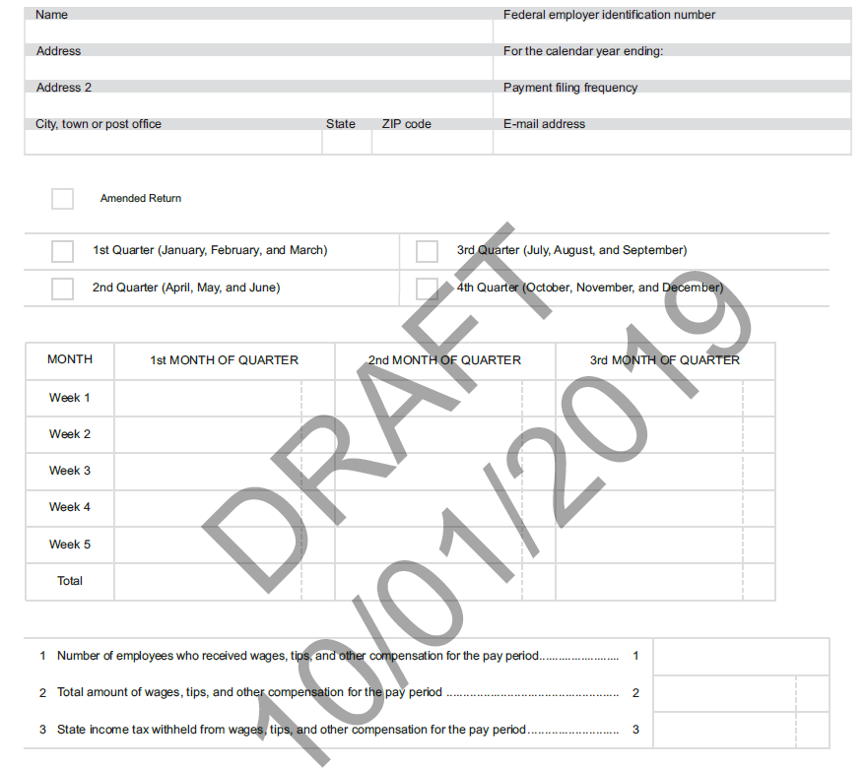
Withholding and Sales Changes

Slide 24
2019 Filing Season
  486K Refunds issued as of 10/28/19
  478K at this point last year
  $305.7M which on pace with last year
  58,485 calls, 8,307 walkins,9,800 emails as of 10/28/19
  RI-1041 will be available for e-file

Slide 25
Income Tax Changes
  Inflationary changes
    Personal Exemptions $4,100
    Standard Deduction
      Single $8,750
      Joint $17,500
      HOH $13,100
    Phaseout $203,850 - $227,050
    Social Security Amounts
      Single $85,150 Joint $106,400
    Pension and Annuity
      Single $83,450 Joint $104,350
  Property Tax Relief Increase from $365 to $385
  Pass-through entity tax impact

Slide 26
Social Security and Pension Modifications
Key factors:
  Modification is based on full retirement age (born before 01/01/1954)
  Filing status, (single, separate, head of household, married joint or widow(er)
  Fed adjusted gross income thresholds (less than $80,000 and $100,000) indexed for inflation
Decreasing modification = taxable amount from federal 1040 line 4d (on latest draft) up to maximum of $15,000 per person
Once AGI limitations are passed, no modification
Does not include IRAs
$15,000 limitation applies per individual for pension/Annuity. Unlimited for SSI
        For example, Wife has taxable pension of $17,000 and husband had $8,000. Modification amount would be $15,000 + $8,000= $23,000. Not $25,000.
    . Pension and Annuity Guidance document

Slide 27
Rhode Island EITC reminders
The Rhode Island EITC is in addition to the Federal EITC. Rhode Island EITC rate is a percentage of the Federal EITC. 2015 = 10.0%; 2016 = 12.5%; 2017 = 15.00%; 2018=15%
Increased rates allow for an increased dollar amount of credit; increases the refund or lowers the amount of tax due; illustration to follow
RI EITC is a refundable credit, which means the credit will be refunded to the taxpayer to the extent it exceeds the taxpayer’s tax liability.
RI conforms to federal eligibility and income thresholds.
RI tax preparer’s regulation includes guidance on due diligence requirements and records retention for EITC and RI-1040H property tax credit.
Tax Preparer's Regulation 280-RICR-20-55-4
If credit ineligibility is suspected, we may need to take extra steps to validate the EITC claim. (Example: requesting documentation of income and expenses)

Slide 28
Form RI-1040H
Property Tax Relief Update
Maximum Credit for 2016 = $385.00
Household income (taxable and nontaxable) = $30,000 or less
One credit per household
Home or dwelling unit must be subject to property tax
Municipal owned public housing is not subject to property tax, therefore credit is disallowed
Nonresidents do not qualify, full-year Rhode Island residents
Must be age 65 or older or disabled (receiving social security disability, SSI or SSDI qualifies)
Responses to previous questions RI-1040H FAQ

Slide 29
Discussion of Extensions
  Extension of Time to File (280-RICR-20-55-2)
  Extension of time to file; Not time to pay
  Definition of a Proper Estimate
    “Proper estimate” means a Rhode Island extension form filed by the regular due date which declares at least eighty percent (80%) of the tax due for the taxable year.
  Extension must be filed on time and have “proper estimate” to be considered valid
  Federal extension is acceptable if no payment is due on 04/15
  Regulation covers “Reasonable Cause” for Waiver of Late Filing Addition to the Tax

Slide 30
Pass Through Entity Tax and Partnership Audits
Michael Canole, Assistant Tax Administrator

Slide 31
Pass Through Entity Taxation Election (44-11-2.3)
  Effective 07/01/19
  Tax payments on behalf of residents and non-residents
  Income tax calculated at 5.99% of RI source income
  BUS-EST used to make estimated payments starting 09/16/19 due date
  Definition of an pass-through entity:
        "Pass-through entity" means a corporation that for the applicable tax year is treated as an S Corporation under I.R.C. 1362(a) (26 U.S.C. § 1362(a)), or a general partnership, limited partnership, limited liability partnership, trust, limited liability company or unincorporated sole proprietorship that for the applicable tax year is not taxed as a corporation for federal tax purposes under the state’s regulations.
  Modification required on Schedule M to add back tax
  Forms and other specifics still being developed

Slide 32
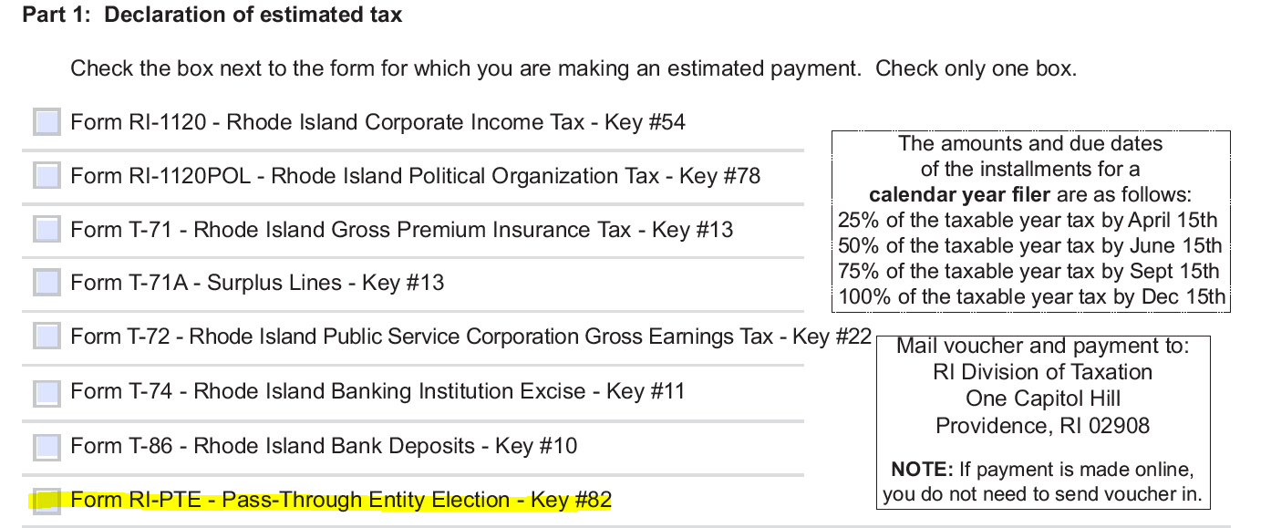
Pass Through Entity Taxation Election (44-11-2.3)

Slide 33
Pass Through Entity Taxation Election (44-11-2.3)
 | Entity Return
Income for Entity |  |  | 1,000,000
Federal K-1 to each partner |  |  | 500,000 |  | RI K1 to each Partner |  | 500,000
 | Federal 1040
Federal AGI |  |  | 500,000 |  | RI AGI |  | 500,000
Tax @ 35% |  |  | 175,000 |  | RI Tax @ 6% |  | 30,000

Slide 34
Pass Through Entity Taxation Election (44-11-2.3)
 | Entity Return Paying RI Entity Tax
Income for Entity |  |  | 1,000,000
RI Entity Tax @6% |  |  | 60,000
Reportable Income |  |  | 940,000
Federal K-1 to each partner |  |  | 470,000 |  | RI K-1 to each partner |  |  | 470,000
 |  |  |  |  | RI Modification increasing |  |  | 30,000
 |  |  |  |  |  |  |  | 500,000
 |  |  |  |  | Credit for RI Entity Tax |  |  | 30,000
Federal AGI |  |  | 470,000 |  | RI AGI |  | 470,000
Tax @ 35% |  |  | 164,500 |  | Modification Increasing |  | 30,000
 |  |  |  |  | RI Modified AGI |  | 500,000
 |  |  |  |  | RI Tax @ 6% |  | 30,000
 |  |  |  |  | Less Credit for Entity Tax |  | 30,000
 |  |  |  |  | Balance due to RI |  | -0-

Slide 35
Pass Through Entity Taxation Election (44-11-2.3)
If No Election for PTE Tax is made |  |  |  |  | If Election to pay PTE Tax was made
Federal Tax (1040) |  |  | 175,000 |  | Federal Tax (1040) |  |  | 164,500
RI Tax(1040) |  |  | 30,000 |  | RI Entity Tax |  |  | 30,000
Total Federal & State Tax |  |  | 205,000 |  | RI Tax (1040) |  |  | -0-
 |  |  |  |  | Total Federal & State Tax |  |  | 194,500
 |  |  |  |  | Tax Savings (205,000-194,500) |  |  | 10,500

Slide 36
Partnership Audits (44-11-2.2(e))
  Federal Law Enacted in 2015
  Enacted for Tax years beginning after 12/31/17
  Termed “Centralized Partnership Audit Regime
    Allows IRS to audit and assess at the partnership level
    Various “opt out” provisions with IRS
  IRS final Regulations have been issued
  RI statute passed as part of the budget bill in July 2019
  RI Statute updated 44-11-2.2 and 44-11-19
  Requires audited partnership to file partnership level return with state and pay tax in same manner as federal audit
  Return and payment required
  More guidance to come
    Looking at new form or part of RI-1065

Slide 37
Excise and Estate Taxes
  Theriza Iafrate

Slide 38
Sales Tax
PRODUCTS / SERVICES THAT BECAME TAXABLE
SAAS (Software as a service): Taxable effective 10/01/2018
Specified Digital Products: Taxable effective 10/01/2019
PRODUCTS / SERVICES THAT BECAME EXEMPT
Feminine Hygiene: Exempt effective 10/01/2019
Urns: Exempt effective 10/01/2019

Slide 39
Sales Tax
Reconciliation Form
T-204A: Class A alcohol ONLY (commonly held by liquor stores)
T-204W: Writers, Artists, Composers ONLY
T-204R: ALL other filers. New fields / categories will be added to the
2019 annual reconciliation form to itemize amounts corresponding to the new tax changes.
  Please DO NOT use prior years forms to file for 2019.

Slide 40
Sales Tax
Remote Sellers
REMOTE SELLER effective 08/17/2017 until 06/30/2019
Remote Seller: RIGL 44-18.2 was enacted into law effective 08/17/2017
Remote sellers with a threshold of $100,000 in gross sales 44-18.2-3(A)(i) and / or 200 transactions 44-18.2-3(A)(ii) in the state of RI MUST Register collect & remit sales tax OR follow the notice requirements
Notice requirements RIGL 44-18.2-3(E)
Post a notice on its website
At the time of purchase
Within forty-eight (48) hours of the time of purchase, notify customers in writing
Each January 31, notify customers in writing who have cumulative annual taxable purchases from the non-collecting retailer totaling one hundred dollars ($100) or more for the prior calendar year.
Each February 15, a non-collecting retailer that has not registered, shall file with the division an attestation that the non-collecting retailer has complied

Slide 41
Sales Tax
Remote Sellers
REMOTE SELLER effective 07/01/2019
ALL remote sellers & marketplace facilitators who meets the sales and / or transactions thresholds, must register, collect & remit sales tax.
The notice requirements is no longer an option.

Slide 42
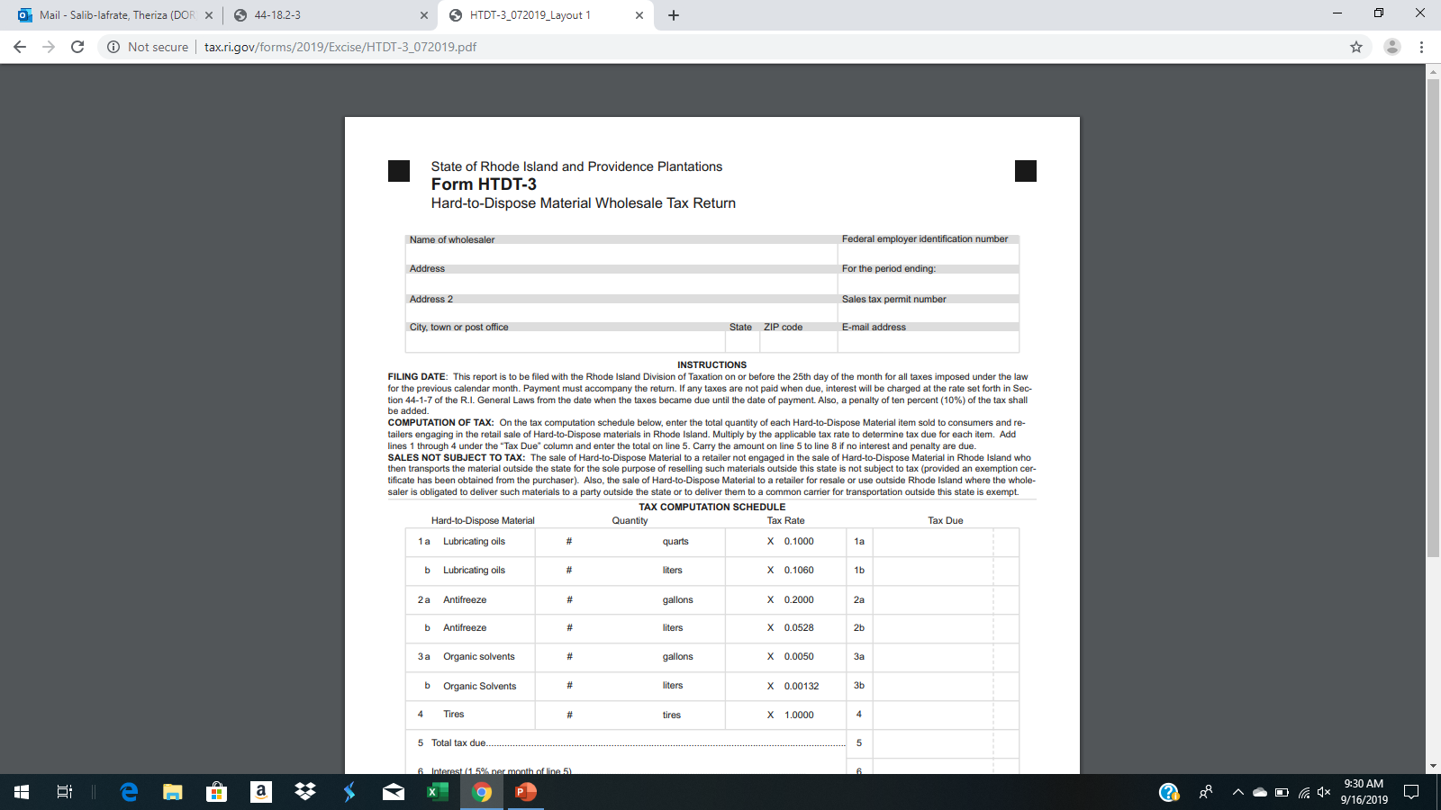
Hard to Dispose Tax
Effective 07/01/2019
    New rates: Shown below
    Form: Varies for type of filer

Slide 43
Excise Tax
Effective 07/01/2019
Beverage Container Tax:
New rate: $0.08 a container Form: BCT-1
Motor Fuel Tax:
New rate: $0.34 a gallon Form: Varies for type of filer
Filling Station:
    New Rate: License fee eliminated
    Form: BAR
Warwick Parking Fee:
New Rate: License fee eliminated
Form: TPO-1

Slide 44
IFTA Tax
Effective 07/01/2019
License Application:
  New Rate: License fee eliminated Form: IFTA-1
License Renewal:
New Rate: License fee eliminated Form: IFTA-REN
Decal Requisition:
New Rate: License fee eliminated Form: IFTA-2

Slide 45
Estate Tax
UPDATE
The section implemented few new processes in 2019 that expedited the clearance turn around time for all returns
Example: If a return is missing a required item such as a death certificate or T-77 copies, an estate section personnel will be calling your office in-lieu of sending a letter in effort to efficiently issue the clearance in a timely manner. If the call goes unanswered we will then send a letter to your office and to the executor or the personal representative of the decedent’s estate.

